Slide 1

Evaluation of computer-tailored motivational messaging in a health-promotion context
J.E. D’Hondt, R.C.Y. Nuijten, P.M.E. Van Gorp

Slide 2

GOAL project
Gamification for Overweight prevention and Active Lifestyle¹
Aim to build theoretical framework for developing personalized eHeath interventions
Includes psychosocial, built environment and health game design factors
Funded by Dutch Ministry of Health
[1] https://healthgoal.eu/

Slide 3




Agenda
Structure of the presentation
Background
Results
Discussion
1 min
6-8 min
4-6 min
1-2 min
1-2 min
~ 5 min
Methods
Conclusions

Slide 4




Background
Literature review
Huge increases in computing power and data collection throughout the last decade
Developments allowed for gaining better insights into customer interactions.
Currently, promotional efforts can be tailored on an individual level²
Research on personalization mainly focused on product recommendation³
[2] G.M. Allenby and P.E. Rossi. “Marketing models of consumer heterogeneity". In: Journal of Econometrics 89 (1999), pp. 57-78
[3] A. Ansari, S. Essegaier, and R. Kohli. “Internet recommendation systems". In: Journal of Marketing Research 37 (2000), pp. 363-375.

Slide 5


Background
Personalized persuasion
Person A
Person B
Person C
Individual differences in preferred persuasion strategy⁴
Creating Adaptive Persuasive Systems
LIMITED TIME OFFER!
USED BY TU/e
PROFS!
These systems have reported promising results
A
B
[4] Maurits Kaptein and Dean Eckles. “Heterogeneity in the Effects of Online Persuasion”, Journal of Interactive Marketing 26.3 (2012), pp. 176–188.

Slide 6
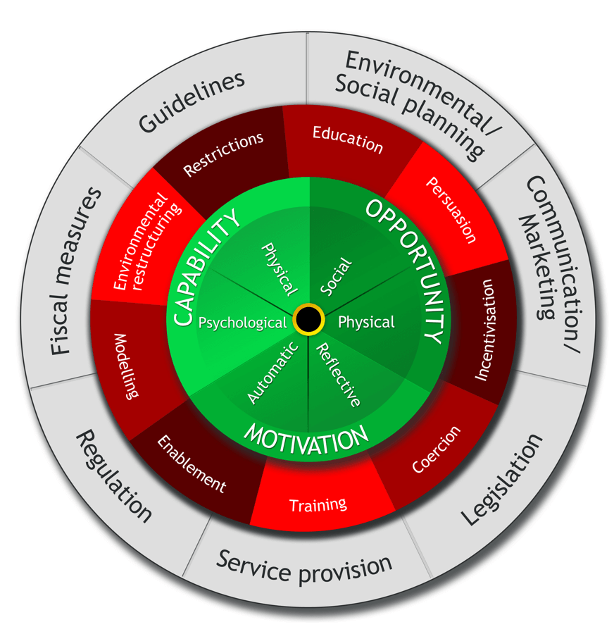



Background
Problems with current research
Success often measured by short-term behavior and attitudes
Some contexts involve stimulation of long-term behavioral change
COM-B model proves that this is not self-evident
The COM-B model⁴
[4] Susan Michie, Maartje M. van Stralen, and Robert West, “The behavior change wheel: A new method for characterizing and designing behavior change interventions”, Implementation Science 6.1 (2011), p. 42

Slide 7


Research questions
Question
1
Question
2
Does adaptive persuasion also work in a health promotion context?
Does AP actually have the ability to provoke behavioral change?

Slide 8
METHODOLOGY

Slide 9


Methodology
System context
User
eHealth app
CHECK NEWSFEED
Users interact with mHealth solutions
EXERCISE
YES
NO
MOTIVATED?
Exercises mostly by own initiative
LOG ACTIVITY
APMA serves to motivate and nudge user into using application

Slide 10


Methodology
System context
APMA
User
eHealth app
CHECK NEWSFEED
Users interact with mHealth solutions
UPDATE USER PROFILE
EXERCISE
YES
NO
FEEDBACK
MOTIVATED?
Exercises mostly by own initiative
LOG ACTIVITY
LOG ACTIVITY
APMA serves to motivate and nudge user into using application

Slide 11





Methodology
APMA requirements
B
Message framing
Frame messages according to a certain persuasion strategy
D
Effectiveness metric
Measure if message was effective
A
User profiles
Identify individual users and their estimated personalities
C
Strategy selection
Clear protocol of what strategy to choose
E
Learning rules
How to update profiles based on reactions to messages

Slide 12
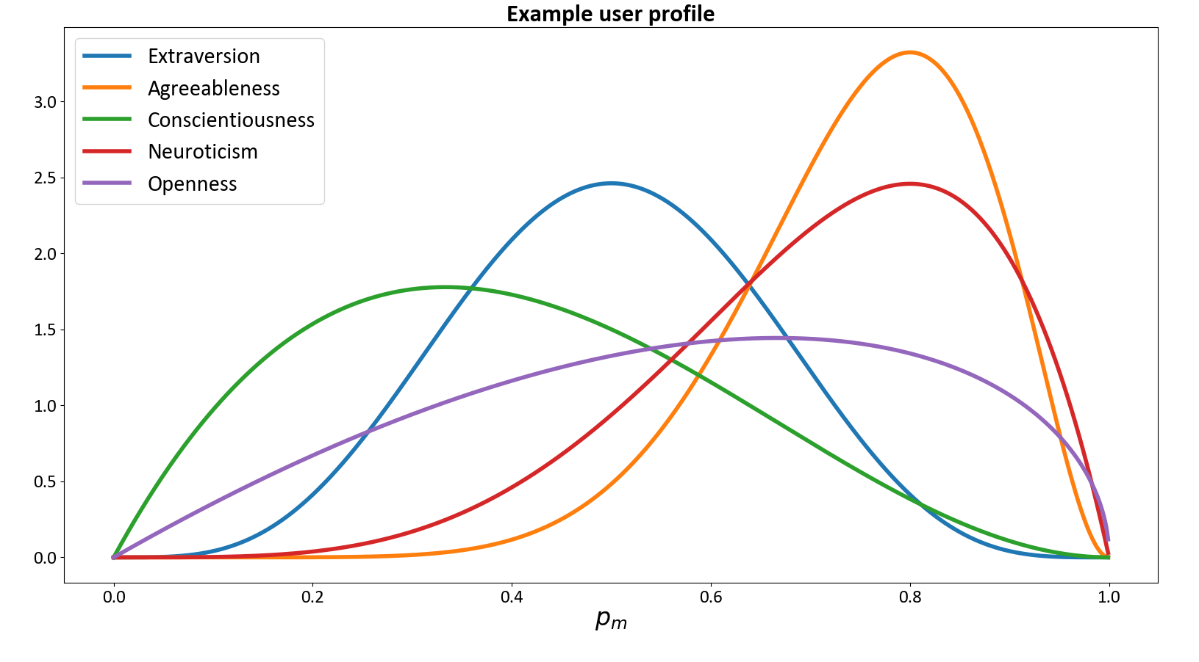
Methodology
APMA Design
A
User Profiling
Collection of Five Beta-Binomial distributions, modeling distribution of estimated success instead of fixed point

Slide 13

Methodology
APMA Design
B
Message framing
Injecting pre-made motivational message into body of message.
Five different messages per trait

Slide 14
Methodology
APMA Design
Individual
COMBINE
DRAW
Chosen strategy:
EXTRAVERSION
C
Average
Strategy selection
Combination of Randomized probability matching and James Stein Shrinkage. Effectively mixing profiles and taking draws from the distributions.

Slide 15
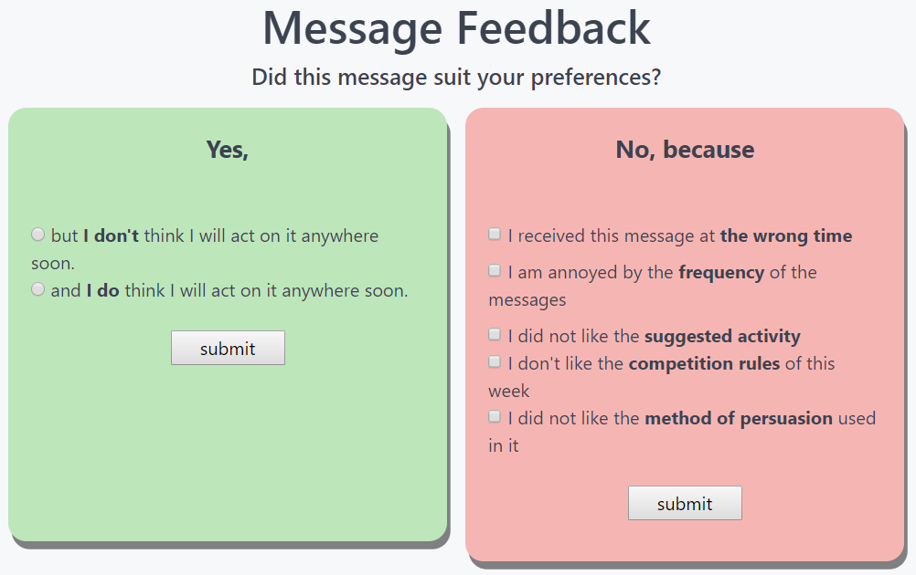
Methodology
APMA Design
D
Effectiveness metric
Both directly via feedback and indirectly via performed behavior.

Slide 16
Methodology
APMA Design
E
Learning rules
Changing mean and variance of distribution in profile based on feedback sentiment.

Slide 17
Methodology
Simulation
RPM + JSS works
As general performance of adaptive is better than randomized
Optimal parameters
λ = 0.13 as participant personality std was 0.8 and short duration.
Optimistic results
Performance in actual intervention is estimated to be lower.

Slide 18
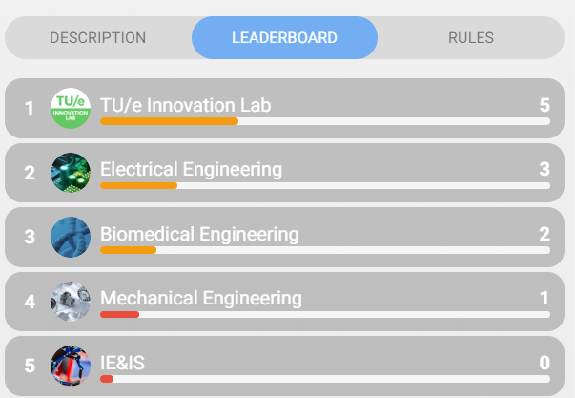
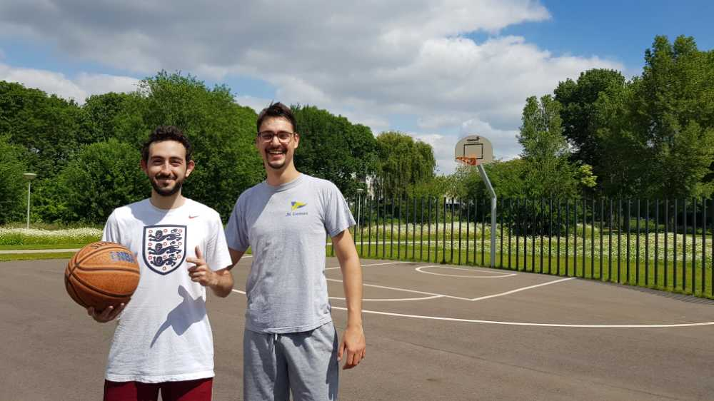
Methodology
Randomized controlled trial
6-week digital health contest among TU/e students/employees
Points earned by performing activities and logging into GameBus
Control: random strategy
Treatment: adaptive persuasion

Slide 19
RESULTS

Slide 20
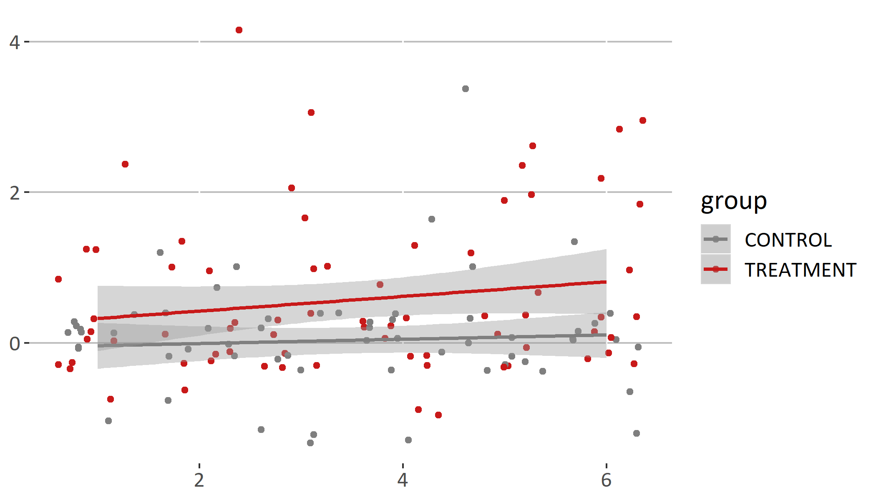

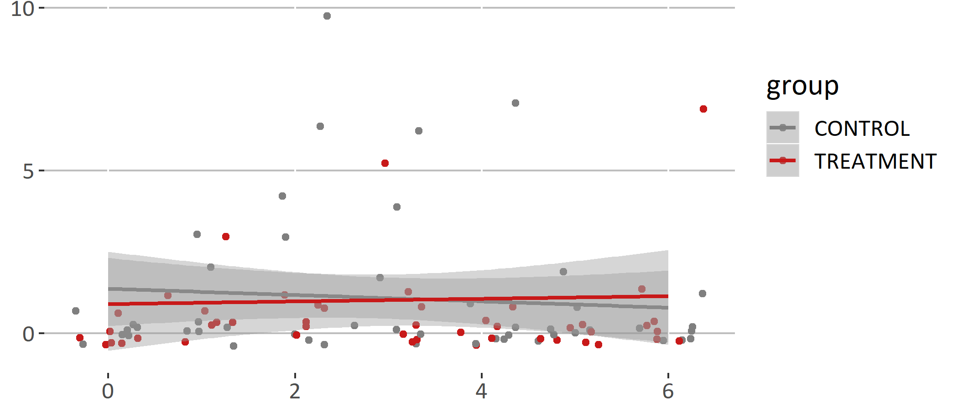

Results
Intervention results
Message Feedback
Participant dropout
Message feedback
N = 149 at start of intervention N = 22 included in analysis
Message performance
Significant difference in message performance between groups
Week
Health Behavior
Health behavior
No significant difference in performed activities between groups
Performed activities
Week

Slide 21

Conclusions
What does this all mean?
01
Adaptive messages increase message feedback, but do not necessarily lead to behavioral change
02
Persuasion small part of bigger puzzle of how to support
change in health behavior
03
Persuasion may generate Motivation, but no Capability and/or Opportunity

Slide 22



Discussion
What paper offers
Guidelines to create adaptive persuasive agents
Validation of APMA in health promotion context
Demonstration of the importance of creating complete interventions

Slide 23
THANK YOU
J.E. d’Hondt, R.C.Y. Nuijten, P.M.E. Van Gorp Eindhoven University of Technology

Slide 24
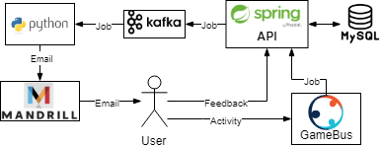
Questions
System overview
Spring API as database manager
Python script for message creation and transmission
Apache Kafka queue which acts as a buffer to prevent job overflow

Slide 25
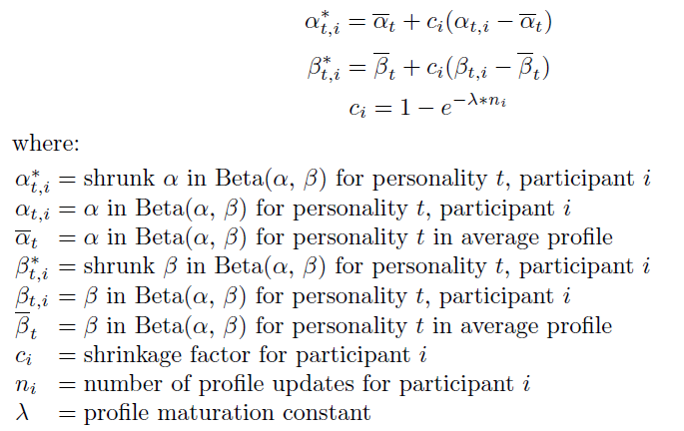
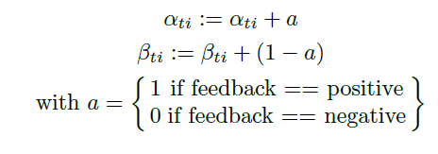
Questions
Equations
James Stein shrinkage
Learning rules

Slide 26
Questions
Limitations
Reasons
01
Small sample size d.t. high drop-out rates and low participant engagement
Automatic participation of TVC participants
02
Manual logging in GameBus
Influence Strategy Choice method. RPM & JSS low computation time, but not optimal
Annoyed with email frequency
03
Activity trigger not so effective. Similar to assignment problem in literature on Reinforcement Learning

Slide 27
Questions
Future research
Evaluation of adaptive persuasion in a complete intervention where personalization of activities is also added
Expanded APMA to consider more context variables like location, agenda etc.
Replication of this research with larger sample size
More positive answer options to get more insight into why people did not act on their feedback.

Slide 28
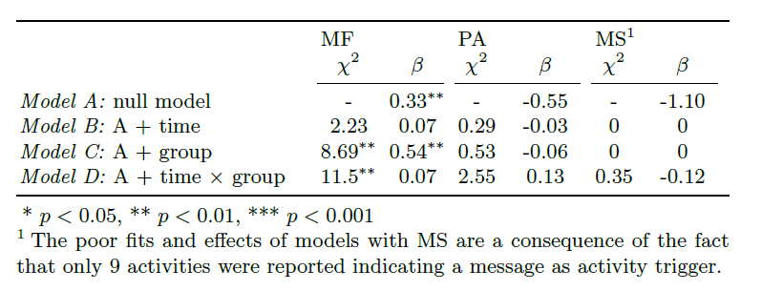
Questions
Results significance
Message Performance
Message performance
Week
Health Behavior
Performed activities
Week

